Slide 1
Operations Update
Community Advisory Committee
April 11, 2023
Notes:
Good afternoon Madam Chair, members of the committee and audience in attendance. I will be presenting today’s Operations Update for the month of February.
Next slide please

Slide 2
Statistics
 | February 2022 | February 2023 | % Change
Vehicle Trips Completed | 175,577 | 226,878 | +29%
Passenger Trips Completed | 222,081 | 280,187 | +26%
Reservation Calls Answered | 145,046 | 178,155 | +23%
ETA Calls Answered | 36,781 | 42,726 | +16%
WMR ETAs Requested | 224,060 | 342,100 | +53%
Notes:
We’ll start with some overall performance statistics based on February 2023, the latest month we have data for. This slide shows a comparison of Vehicle Trips Completed, Passenger Trips Completed, Reservation Calls Answered, ETA Calls Answered and Where’s My Ride ETA Requests for February 2022 and February 2023.
For the month of February 2023, over 226,000 vehicle trips were completed. This is a 29% increase compared to the previous February. In addition, there were also over 280,000 passenger trips completed. There were also over 178,000 reservation calls answered, as well as just over 42,000 ETA calls answered which is up 16% from last February. As well, we continue to see strong use of the Where’s My Ride app for estimated time of arrival requests, with over 342,000 Where is My Ride ETAs requested which are up 53% from last year.
Next Slide Please

Slide 3
Performance Report Card
Key Performance Indicator | Standard | February 2023 | FY23 through February 2023
On Time Performance | ≥ 91% | 90.9% | 90.9%
Excessively Late Trips | ≤ 0.10% | 0.04% | 0.05%
Excessively Long Trips | ≤ 5% | 3.8% | 3.9%
Missed Trips | ≤ 0.75% | 0.41% | 0.47%
Denials | ≤ 0 | 1 | 3
Access to Work On Time Performance | ≥ 94% | 94.9% | 95.1%
Average Hold Time in seconds (Reservations) | ≤ 120 | 55 | 61
Calls On Hold > 5 Min (Reservations) | ≤ 5% | 2.2% | 2.4%
Calls On Hold > 5 Min (ETA) | ≤ 10% | 2.1% | 2.1%
Complaints Per 1,000 Trips | ≤ 4.0 | 2.6 | 2.9
Preventable Incidents per 100,000 Miles | ≤ 0.25 | 0.17 | 0.20
Preventable Collisions per 100,000 Miles | ≤ 0.75 | 0.85 | 0.86
Miles Between Road Calls | ≥ 25,000 | 35,248 | 41,166
Green is good, yellow is cautiously optimistic, red is not meeting standard
Notes:
Looking at the systemwide performance report card, we had a strong February 2023 where we met 10 of the 13 key performance indicators. Average initial hold time finished at 55 seconds, excessively long trips ended at 3.8%, and preventable incidents ended at 0.17 to just name a few.
However, We did have a denial in the Southern Region occur. The Call taker offered two times outside of the negotiation window. Global Paratransit has already acted on the incident with the CSR.
For the fiscal year, which includes the first 8 months, 10 of 13 KPI standards have been met.
On time performance for the fiscal year is tracking at 90.9%, the preventable collision rate is tracking at 0.86 per 100,000 miles, and there have been now three denials.
Next slide please.
*If Asked (The preventable collision trend is high for the year due to curbing incidents, however in an effort to limit curbing, Access created a video that was sent to the contractors to assist with contractors’ ongoing campaigns. Additionally posters with safety messages were sent to the contractors to assist with their safety campaigns as well. These occurrences are trending down after these efforts which we can see in January’s data for the year.)
*If Asked about denials (Both occurrences occurred in September in the Northern Region and Santa Clarita Region. SC’s was caused by a call taker error; they took it upon themselves to enter a different time for the customer. Call taker has been retrained to proficiency. MV’s was caused by a call taker error; call taker offered two times outside of the negotiation window. Call taker has been retrained to proficiency. )

Slide 4
Vehicle Procurement Status
58 small Ram ProMasters scheduled to be built in Corona starting in mid-April
14 cutaways being built in Indiana; expected delivery by end of July
2 Class C cutaway build is complete; were shipped last week
11 large Ram ProMasters being built; delivery due in May
Notes:
In terms of vehicle acquisition. a build of 58 small Ram ProMaster vans, available due to a cancellation from a RV manufacturer, will start in Corona in mid-April.
A build of 14 Cutaways in Indiana were inspected by our Senior Fleet Manager a couple of weeks ago; delivery is expected by the end of July.
2 StarCraft Class C cutaways that Access ordered in November 2021, have been completed were shipped to California last week.
Finally, our build of 11 large Ram ProMasters is almost complete and delivery is expected by mid-May.
Next slide please
NOTE: the base-price of the Ram Promaster 136-inch wheelbase model has increased from $87,000 to $125,000.

Slide 5
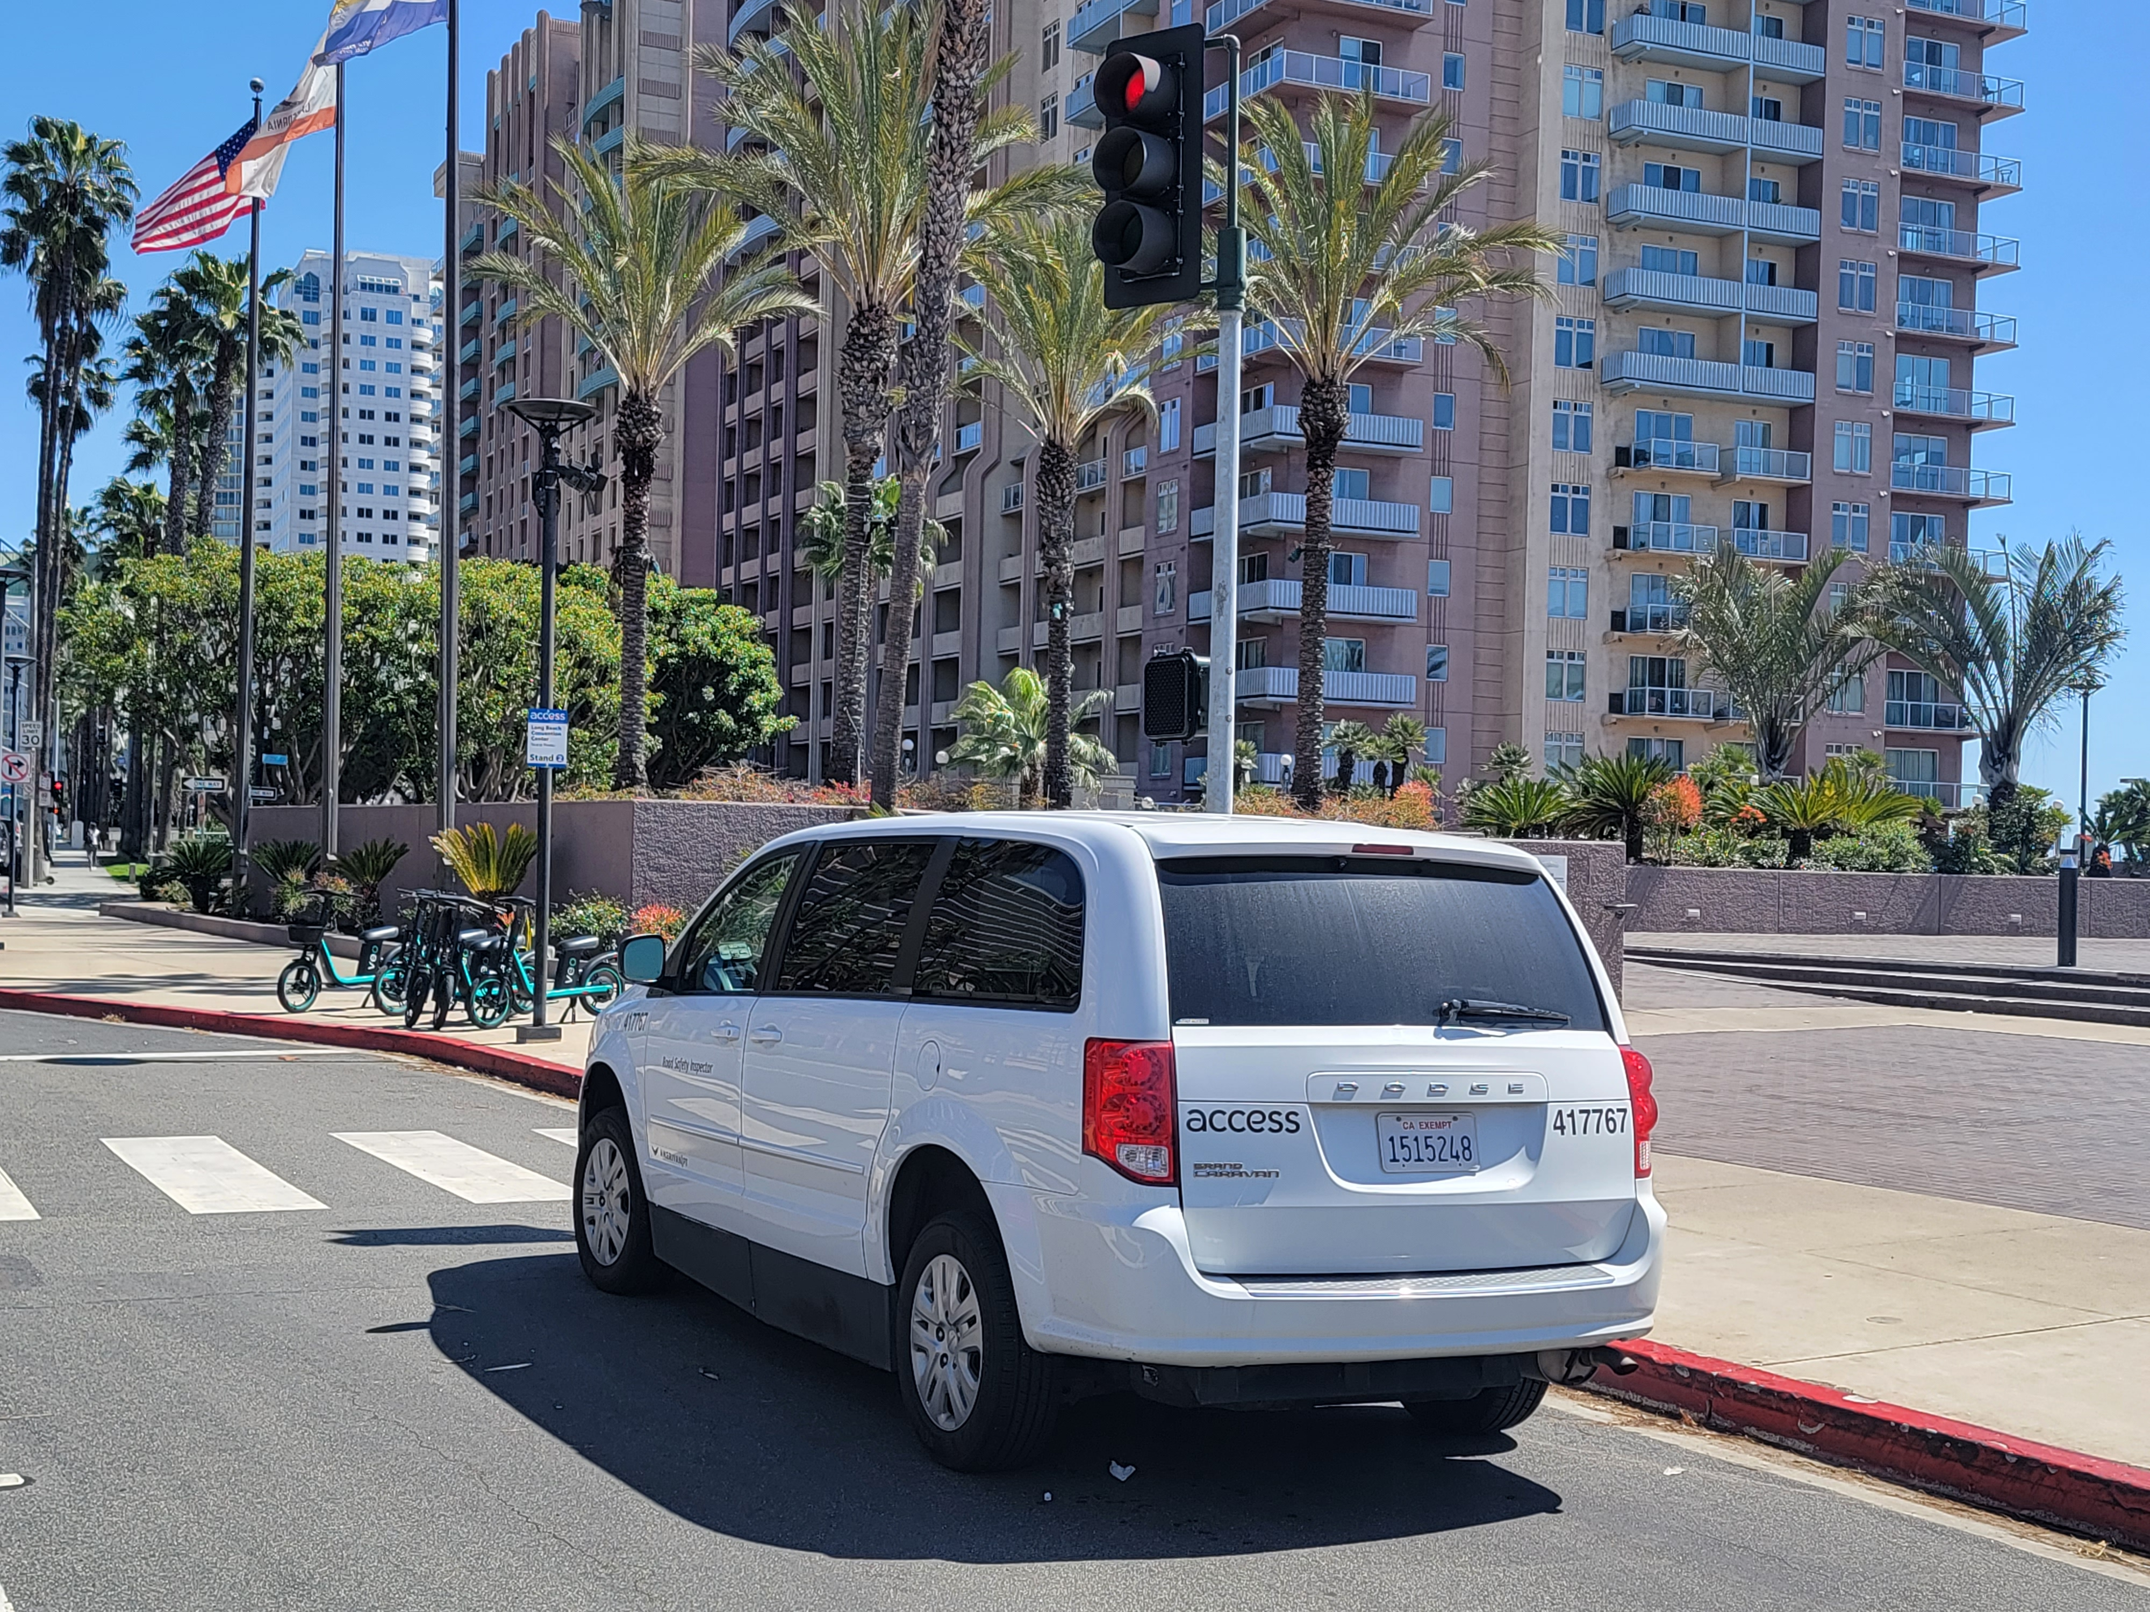
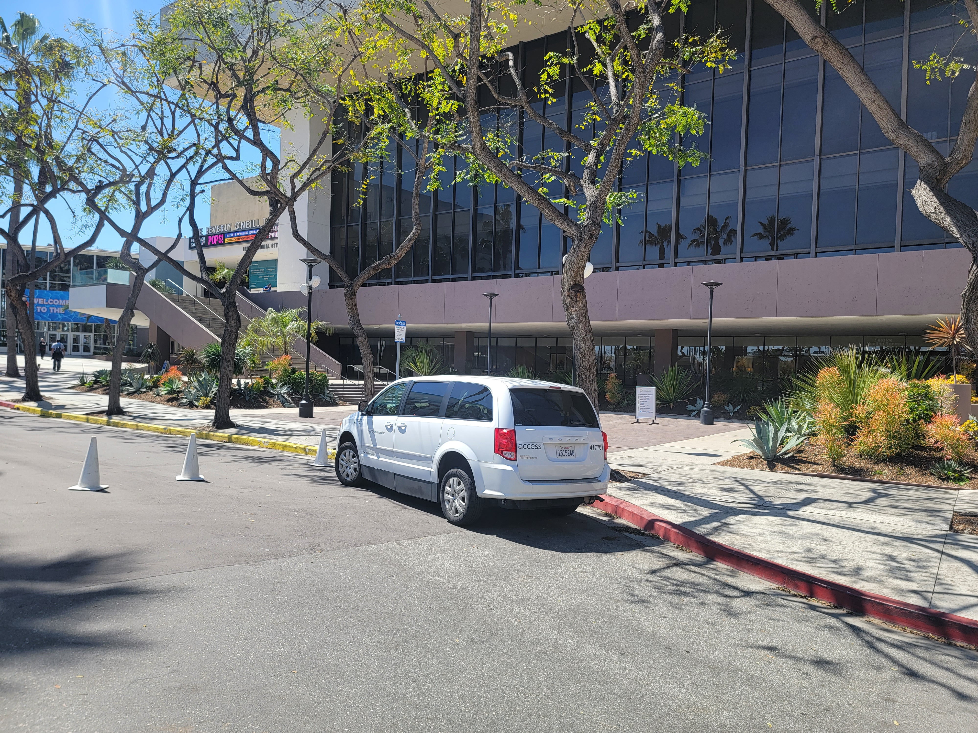
Highlights
Access attended the Accessibility Advisory Committee Meeting held in Santa Clarita
Access attended and assisted at the Abilities Expo
Access Executive Management takes a brief ride in the new autonomous accessible vehicle
New Access Stands installed at Long Beach Convention Center
Notes:
Here are some Highlights we would like to share
Access staff attended the Accessibility Advisory Committee Meeting held in Santa Clarita on March 2nd
Next, Access staff assisted with the pickups and drop offs at the Abilities Expo from March 10 to March 12, where Access also shared a booth with LA Metro to speak to participants at the expo along with answer questions as well.
Also, Access Executive Management had a chance to take a brief ride in the new autonomous accessible vehicle that Lilee Systems is building in San Jose in partnership with Access. Plans are being considered to bring the vehicle to Los Angeles so the community could take part in demos.
Lastly, three new Access stand signs were installed at the Long Beach Convention Center. Pictured is stand sign 2 which is located Ocean Blvd in front of the Terrace Theater, and stand sign 3 which is located on Hart Pl just across E Seaside Way. Stand 1 has been installed and located on Pine Ave. ,but is currently blocked off from taking pictures of the sign due to the preparation for the Long Beach Grand Prix, and the picture and location of stand 1 will be updated on the Access website later this month.
And with that, I’ll be happy to take questions.

